Slide 1

SEMINAR
SIMPLE AND MULTIPLE LINEAR REGRESSION

Slide 2
INTRODUCTION:
Regression analysis is a statistical technique for investigating and modelling the relationship between variables.
Applications of regression are numerous and occur in almost every field, including:
Engineering
Physical and Chemical Sciences
Economics
Management
Life and biological sciences
Social sciences.

Slide 3
Example:
Suppose that an industrial engineer employed by a soft drink beverage bottler is analysing the product delivery and service operations for vending machines.
He assumes that the time required by a route deliveryman to load and service a machine is related to the number of cases of product delivered.
The engineer visits 25 randomly chosen retail outlets having vending machines and inspects the outlet delivery time (in minutes) and the volume of product delivered (in cases).
When we plot these observations, we get a scatter diagram.

Slide 4
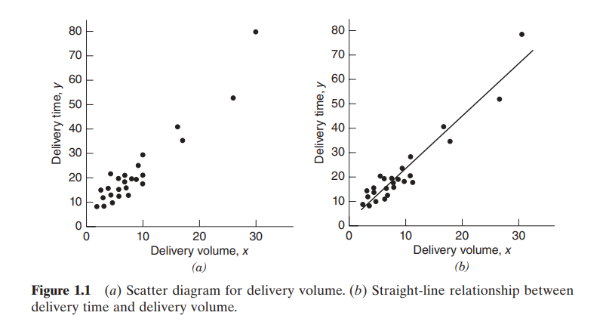
This figure clearly suggests a relationship between delivery time and delivery volume; in fact, the impression is that the data points generally, but not exactly, fall along a straight line.

Slide 5
If we let Y represent delivery time and X represent delivery volume, then the equation of a straight line relating these two variables is:
Y = α + β (X)
where α is the intercept and β is the slope.
We see that the data points do not fall exactly on a straight line, so we modify this using the error term, which is the difference between the y and the straight line thus, the equation becomes :
Y = α + β (X) + ε
where ε denotes the error term.
This is called a simple linear regression model. X is called the independent variable, and Y is called the dependent variable. X is the predictor or regressor variable, and Y is the response variable.
Since the equation involves only one regressor variable, it is called a simple linear regression model.
In general, the response variable y may be related to k regressors, X1, X2, ..., Xk, so that
Y= α + β₁ (X₁) + β₂ (X₂) + … + ε
This is called a multiple linear regression model because more than one regressor is involved.

Slide 6
Assumptions of simple linear regression model :
1) Y is linearly related to X
2) Expectation of the error term is zero
3) Variance of the error term is σ²
4) Error term follows normal distribution with mean 0 and variance σ²
5) X is uncorrelated with error term.
Assumptions of GLM:
1) Assumption of linearity
2) Assumption of normality
3) Assumption of non-multicollinearity
4) Assumption of non-stochastic regressors
5) Assumption of unbiasedness
6) Assumption of homoscedasticity
7) Assumption of no measurement errors

Slide 7
An important objective of regression analysis is to estimate the unknown parameters in the regression model. This process is also called fitting the model to the data. There are so many techniques to estimate parameters say method of least squares, ordinary least squares, maximum likelihood estimate, etc.
The next phase of regression analysis is called model adequacy checking, in which the appropriateness of the model is studied and the quality of the fit ascertained.
Through such analyses, the usefulness of the regression model may be determined. The outcome of adequacy checking may indicate either that the model is reasonable or that the original fit must be modified. Thus, regression analysis is an iterative procedure in which data lead to a model, and a fit of the model to the data is produced. The quality of the fit is then investigated, leading either to modification of the model or to the adoption of the model.

Slide 8
USES:
Regression models are used for several purposes, including the following:
1. Data description
2. Parameter estimation
3. Prediction and estimation
4. Control
Engineers and scientists frequently use equations to summarize or describe a set of data. Regression analysis is helpful in developing such equations. For example, we may collect a considerable amount of delivery time and delivery volume data, and a regression model would probably be a much more convenient and useful summary of those data than a table or even a graph.
Regression analysis is also used in the estimation of unknown parameters. We fit the data to a model and then provide an estimate of its parameters.
Many applications of regression involve prediction of the response variable. For example, we may wish to predict the delivery time for a specified number of cases of soft drinks to be delivered. These predictions may be helpful in planning delivery activities such as routing and scheduling or in evaluating the productivity of delivery operations.
Regression models may be used for control purposes. For example, a chemical engineer could use regression analysis to develop a model relating the tensile strength of paper to the hardwood concentration in the pulp. This equation then be used to control the strength to suitable values by varying the level of hardwood concentration. When a regression equation is used for control purposes, it is important that the variables be related in a causal manner.

Slide 9
Simple Linear Regression
OUTLINE:
Simple linear regression model
Model parameters
Method of least squares
Distribution of error terms
Estimation of regression parameters
INTRODUCTION:
Simple linear regression is used to estimate the relationship between two quantitative variables. We can use simple linear regression when we want to know:
1. How strong the relationship is between two variables (e.g., the relationship between rainfall and soil erosion).
2. The value of the dependent variable at a certain value of the independent variable (e.g., the amount of soil erosion at a certain level of rainfall).

Slide 10
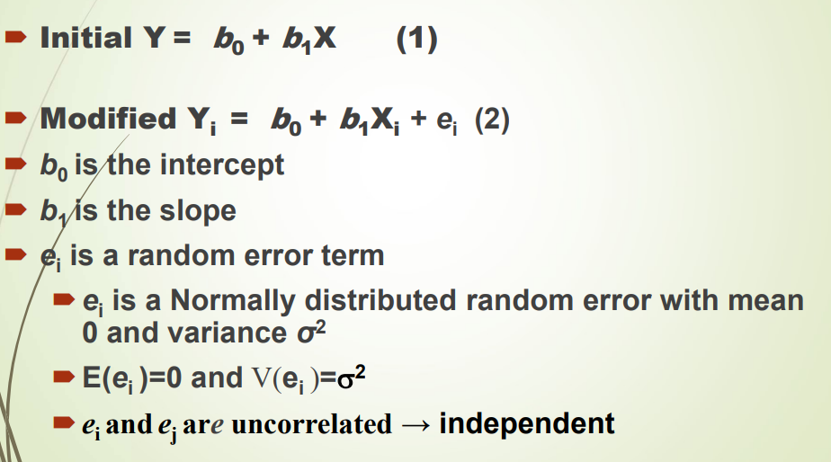
Simple Linear Regression Model

Slide 11
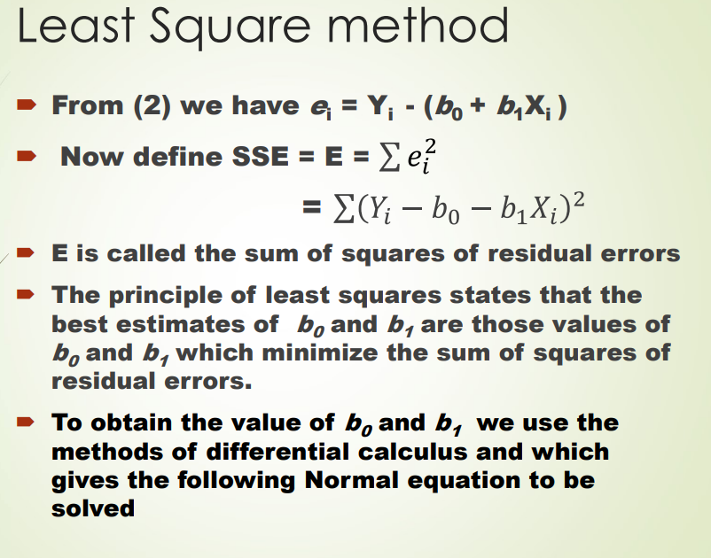
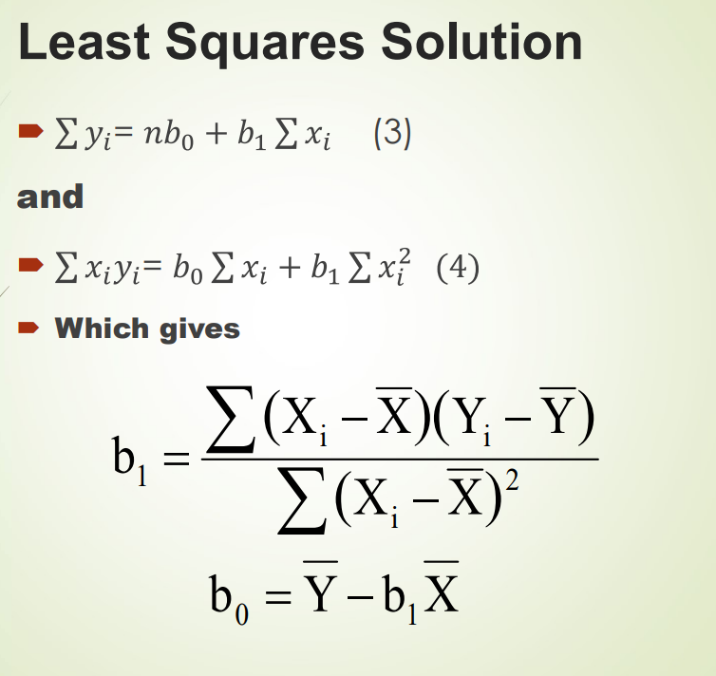
Least squares method:

Slide 12
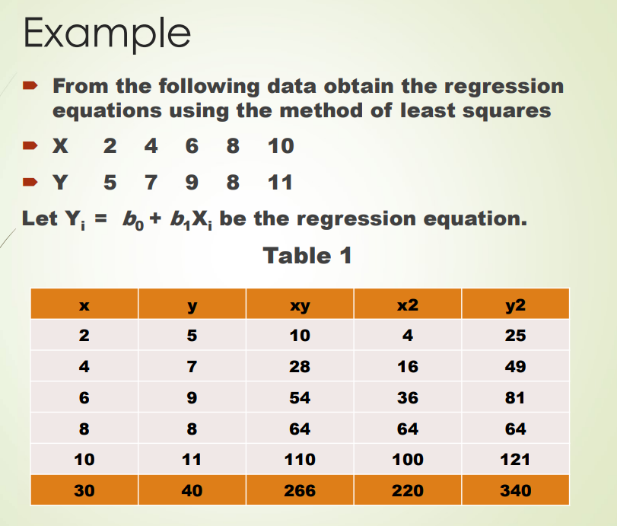
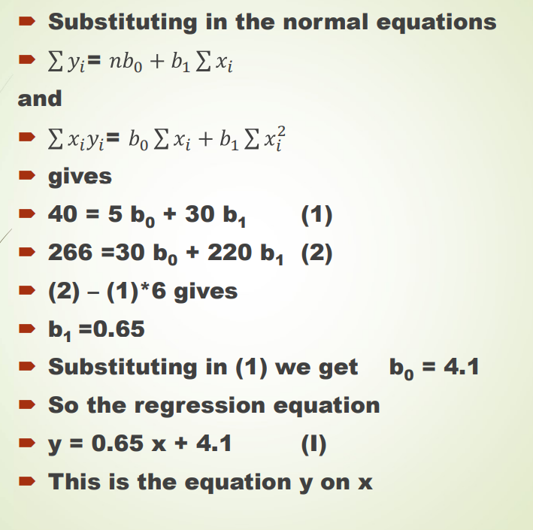
example

Slide 13
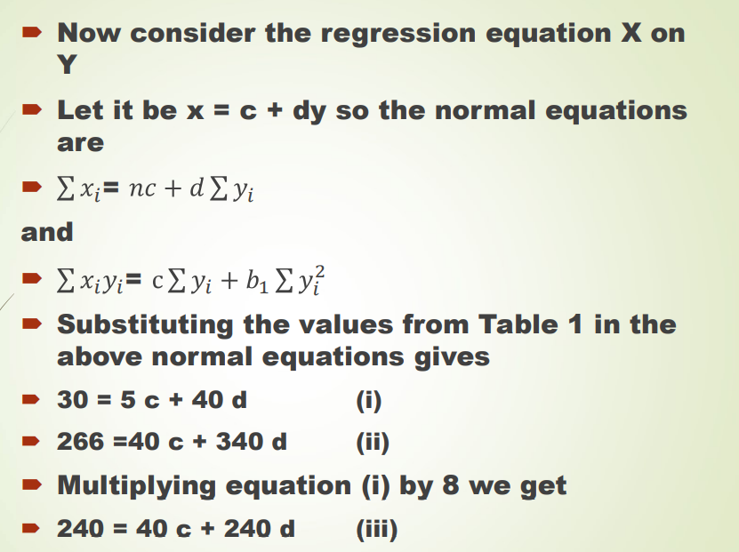
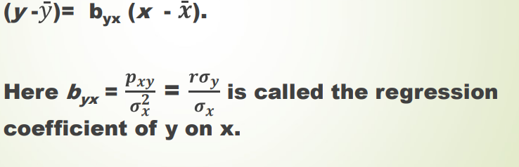
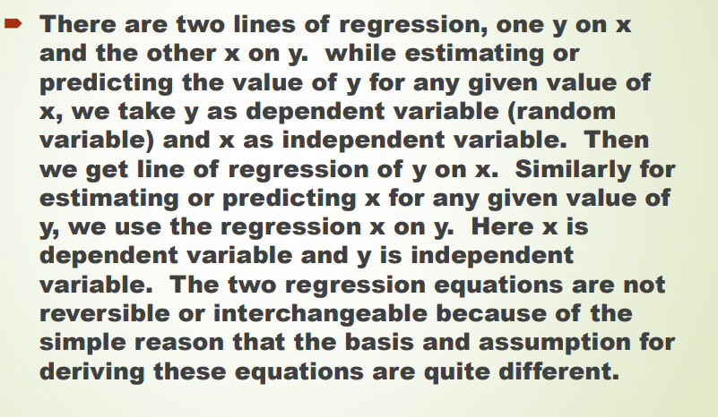
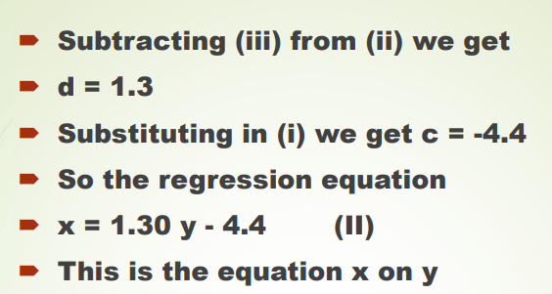
Regression Equation of y on x is given by-

Slide 14
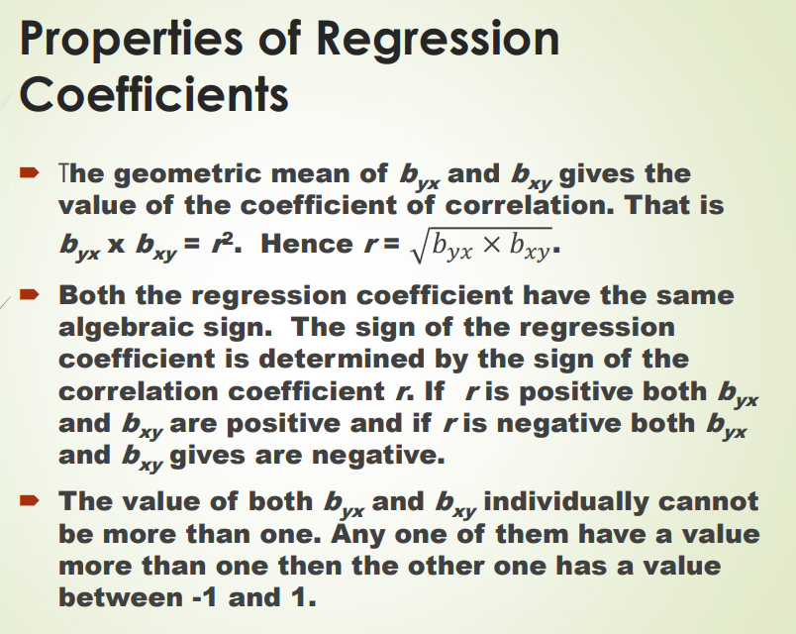
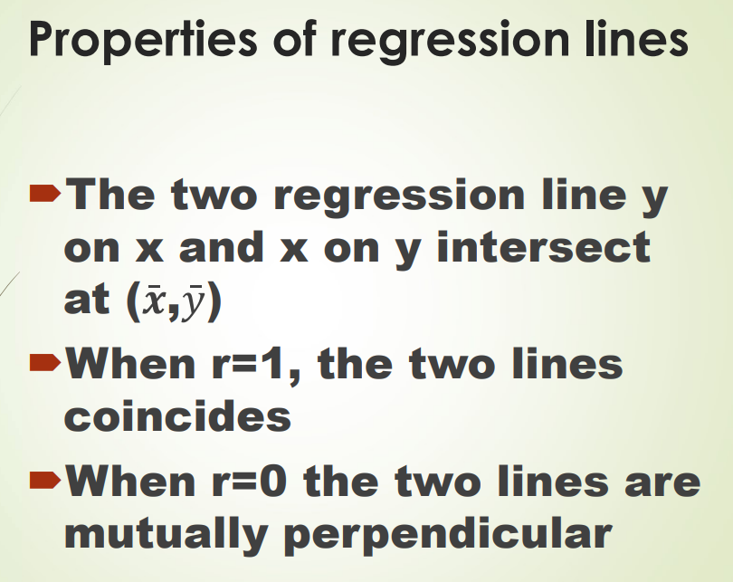
Properties:

Slide 15
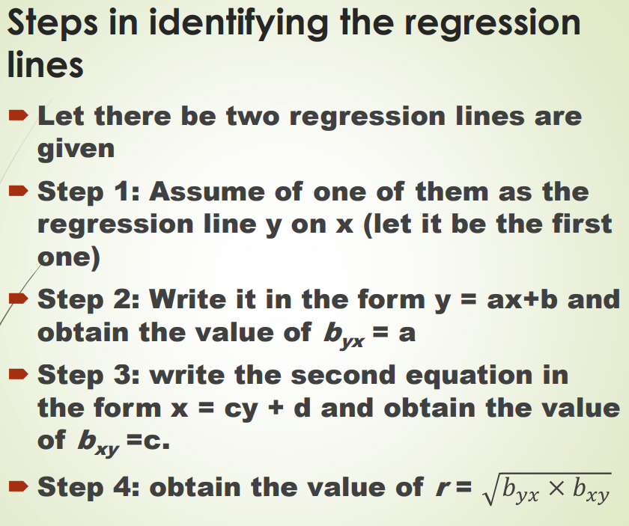
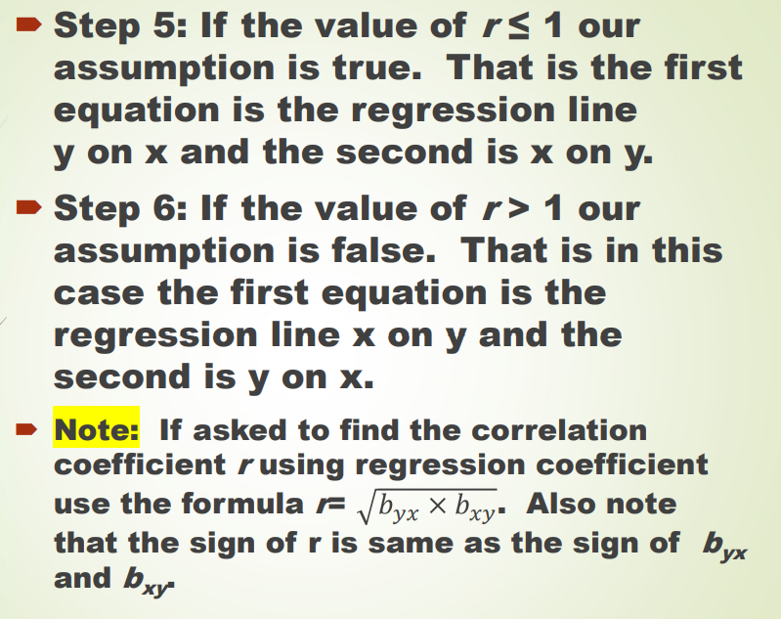
Steps:

Slide 16
Multiple linear regression :
A regression model that involves more than one regressor variable is called a multiple regression model. The goal of multiple linear regression is to model the linear relationship between the explanatory (independent) variables and response (dependent) variables. In essence, multiple regression is the extension of ordinary least-squares (OLS) regression because it involves more than one explanatory variable. Multiple regression model that might describe this relationship is:
y = β0 +β1x1 +β2x2 +ε
where y denotes the yield, x 1 denotes the temperature, and x 2 denotes the catalyst concentration. This is a multiple linear regression model with two regressor variables.
In general, the response y may be related to k regresors or predictor variables .
The model:
y = β0 +β1x1 +β2x2 +…+βkxk +ε
is called a multiple linear regression model with k regressors. The parameters β j , j = 0, 1, . . . , k , are called the regression coefficients.

Slide 17
ASSUMPTIONS of the general model:
Five main assumptions underlying multiple regression models must be satisfied:
(1) Linearity
(2) Normality of error terms
(3) No Multicollinearity.
(4) Homoskedasticity
(5) No autocorrelation.
Now, we shall look at these assumptions in brief:

Slide 18
Linearity: Multiple linear regression assumes that there is a linear relationship between each predictor variable and the response variable. The easiest way to determine if this assumption is met is to create a scatter plot of each predictor variable and the response variable. This allows us to see visually if there is a linear relationship between the two variables. If the points in the scatter plot roughly fall along a straight diagonal line, then there likely exists a linear relationship between the variables.
Normality: There are two common ways to check if this assumption is met:
Check the assumption visually using Q-Q plots. A Q-Q plot, short for quantile-quantile plot, is a type of plot that we can use to determine whether or not the residuals of a model follow a normal distribution. If the points on the plot roughly form a straight diagonal line, then the normality assumption is met.
Check the assumption using a formal statistical test like Shapiro-Wilk, Kolmogorov-Smirnov, Jarque-Barre, or D’Agostino-Pearson. Keep in mind that these tests are sensitive to large sample sizes – that is, they often conclude that the residuals are not normal when your sample size is extremely large. This is why it’s often easier to use graphical methods like a Q-Q plot to check this assumption.

Slide 19
No Multicollinearity: Multiple linear regression assumes that none of the predictor variables are highly correlated with each other. When one or more predictor variables are highly correlated, the regression model suffers from multicollinearity, which causes the coefficient estimates in the model to become unreliable. The easiest way to determine if this assumption is met is to calculate the VIF value for each predictor variable. VIF values start at 1 and have no upper limit. As a general rule of thumb, VIF values greater than 5 indicate potential multicollinearity.
No Autocorrelation: Multiple linear regression assumes that each observation in the dataset is independent. The simplest way to determine if this assumption is met is to perform a Durbin-Watson test, which is a formal statistical test that tells us whether or not the residuals (and thus the observations) exhibit autocorrelation. Depending on the nature of the way this assumption is violated, you have a few options:
For positive serial correlation, consider adding lags of the dependent and/or independent variable to the model. For negative serial correlation, check to make sure that none of your variables are over-differenced.
For seasonal correlation, consider adding seasonal dummy variables to the model.

Slide 20
Homoscedasticity: Multiple linear regression assumes that the residuals have constant variance at every point in the linear model. When this is not the case, the residuals are said to suffer from heteroscedasticity. . When heteroscedasticity is present in a regression analysis, the results of the regression model become unreliable. Specifically, heteroscedasticity increases the variance of the regression coefficient estimates, but the regression model doesn’t pick up on this. This makes it much more likely for a regression model to declare that a term in the model is statistically significant, when in fact it is not.
The simplest way to determine if this assumption is met is to create a plot of standardized residuals versus predicted values. Once you fit a regression model to a dataset, you can then create a scatter plot that shows the predicted values for the response variable on the x-axis and the standardized residuals of the model on the y-axis. We also use the Breusch-Pagan test to check the homoscedasticity.

Slide 21
Applications and real life examples:
Scientists might use different amounts of fertilizer and water on different fields and see how it affects crop yield. They might fit a multiple linear regression model using fertilizer and water as the predictor variables and crop yield as the response variable:
crop yield = β₀ + β₁(amount of fertilizer) + β₂(amount of water)
Data scientists for professional sports teams often use linear regression to measure the effect different training regimens have on player performance. Data scientists in the NBA might analyze how different amounts of weekly yoga sessions and weightlifting sessions affect the number of points a player scores:
points scored = β₀ + β₁(yoga sessions) + β₂(weightlifting sessions)

Slide 22
MODEL ADEQUACY
R-squared (R²):
It measures the proportion of the variation in the dependent variable explained by all of the independent variables in the model. It assumes that every independent variable in the model helps to explain variation in the dependent variable. In reality, some independent variables (predictors) don't help to explain the dependent (target) variable. In other words, some variables do not contribute in predicting the target variable.
Mathematically, R-squared is calculated by dividing the sum of squares of residuals (SSres) by the total sum of squares (SStot) and then subtracting it from 1. In this case, Sstot measures the total variation. SSreg measures explained variation, and SSres measures the unexplained variation.

Slide 23
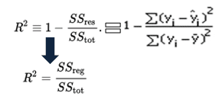
As SSres + SSreg = SStot, R² = Explained variation / Total Variation
R-Squared is also called the coefficient of determination. It lies between 0% and 100%. An R-squared value of 100% means the model explains all the variation of the target variable. And a value of 0% measures zero predictive power of the model. Higher the R-squared value, better the model.

Slide 24
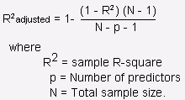
ADJUSTED R-SQUARED:
It measures the proportion of variation explained by only those independent variables that really help in explaining the dependent variable. It penalizes you for adding independent variable that do not help in predicting the dependent variable.
Adjusted R-squared value can be calculated based on the value of R-squared, number of independent variables (predictors), total sample size.

Slide 25

Adjusted R-Squared can be calculated mathematically in terms of sum of squares. The only difference between R-square and Adjusted R-square equation is degree of freedom.
In the above equation, d.ft is the degrees of freedom n– 1 of the estimate of the population variance of the dependent variable, and dfe is the degrees of freedom n – p – 1 of the estimate of the underlying population error variance.
Purpose of adjusted R-square:
Adjusted R-square should be used to compare models with different numbers of independent variables. Adjusted R-square should be used while selecting important predictors (independent variables) for the regression model.

Slide 26

Difference between R-square and Adjusted R-square:
1. Every time we add an independent variable to a model, the R-squared increases, even if the independent variable is insignificant. It never declines. Whereas Adjusted R-squared increases only when the independent variable is significant and affects the dependent variable. In the table below, the adjusted R-squared is maximum when we include two variables. It declines when a third variable is added. Whereas R-squared increases when we include the third variable. It means the third variable is insignificant to the model.
2. Adjusted R-squared can be negative when the R-squared is close to zero.
3. Adjusted R-squared value always be less than or equal to the R-squared value.

